Slide 1

Privacy-Preserving Outbreak Surveillance: Enabling Stronger Differential Privacy Through Geospatially-Aware Machine Learning
MAI (Computer Engineering)
Dissertation 2025/26
Supervisor: Dr. Ciaŕan McGoldrick
Presented By: Shreshtha Kamboj
Student Id: 23364317
Notes:
Good afternoon, my name is Shreshtha Kamboj and today I will be presenting my dissertation titled “Privacy-Preserving Outbreak Surveillance: Enabling Stronger Differential Privacy Through Geospatially-Aware Machine Learning”
This research explores how we can analyze disease outbreak data while still protecting sensitive patient information.
Before diving into the technical aspects, I will first introduce the key concepts behind DP and explain why privacy preserving analysis is so important in healthcare datasets.

Slide 2

Agenda
What is DP?
What problem does it solve?
How does it apply in medical datasets?
Why choose a medical health dataset?
GOAL
Approach overview
Evaluation
Results
Future work
Report outline
Notes:
Here is a quick overview of the structure of this presentation.

Slide 3
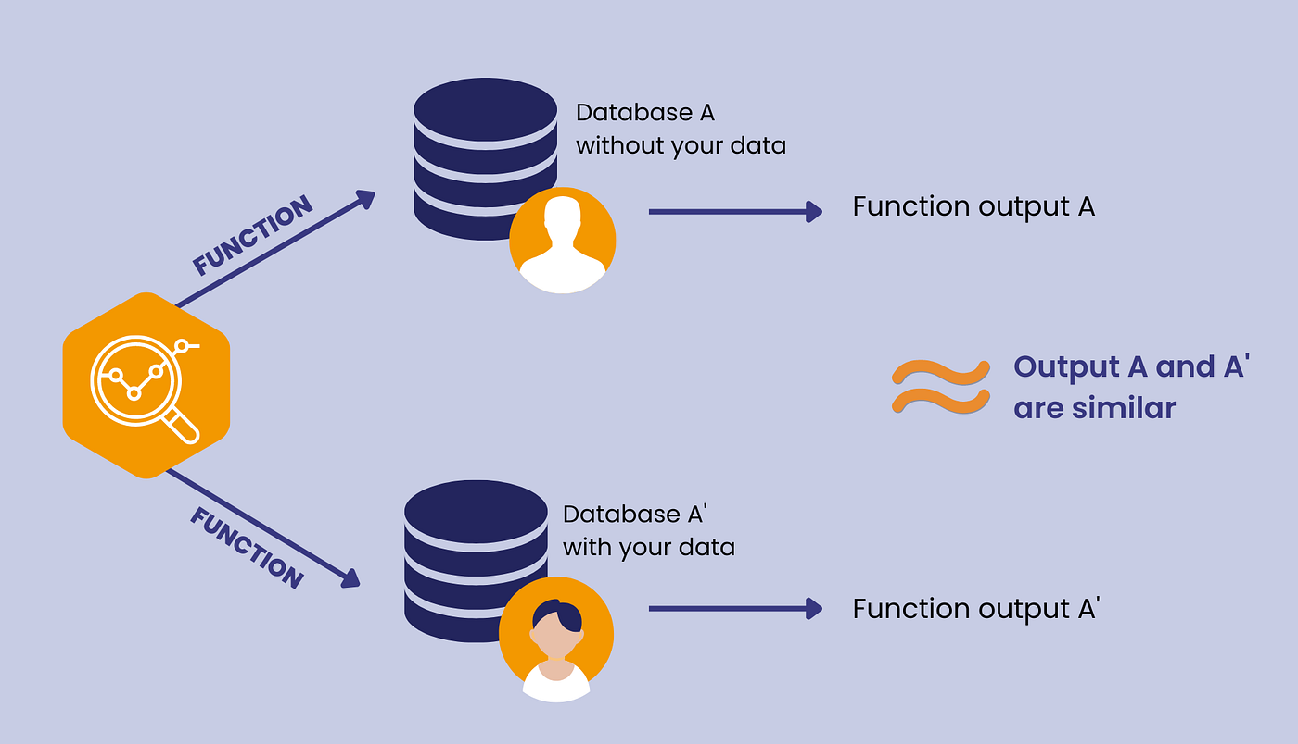
What is DP?
Differential privacy is a mathematically rigorous framework for analyzing and sharing statistical information about datasets while safeguarding the privacy of individual participants.
It states that if you run the same analysis on two datasets that are identical except for one individual record, the resulting outputs must be nearly indistinguishable.
It achieves this by injecting carefully calibrated random noise into data computations, ensuring that the aggregate patterns of a group can be analyzed without exposing specific individual records.
Notes:
DP is a mathematical framework used to protect individual data while still allowing useful statistical analysis. The key idea is that the output of a dataset analysis should not significantly change whether or not any single individual’s data is included in the dataset.
To achieve this, DP adds carefully calibrated random noise to the results of queries or statistical computations. However, while privacy improves with stronger noise, the accuracy of the data decreases, which creates an important privacy-utility trade-off.

Slide 4
What problem does it solve?
Re-identification and Linkage Attacks
Data Silos and Restricted Sharing
Unquantifiable Privacy Loss
Example: “Tech companies and government bodies use this framework to solve practical data collection challenges. For instance, Apple and Google use it to gather user behavior data to improve predictive text and software features without tracking individual users' specific actions.”
Notes:
The main problem DP addresses is data leakage during statistical analysis. Even if the datasets remove obvious identifiers such as names or addresses, individuals can still sometimes be re-identified through combining multiple attributes, such as age, location, or medical condition.
Read example on the slide
This shows that DP is not just a theoretical concept, but it is already being used in real-world systems.

Slide 5

How does it apply in medical datasets?
In the healthcare and medical fields, differential privacy acts as a critical bridge between strict data protection regulations (like HIPAA or GDPR) and the need for large-scale medical research. Medical datasets contain highly sensitive, granular details—such as diagnoses, genetic markers, and treatment histories—that are incredibly valuable for training predictive models and finding disease trends.
Secure Collaborative Research
Sanitizing Medical Documents and AI
Notes:
Healthcare datasets are among the most sensitive types of data. They contain extremely, detailed information such as diagnoses, treatments, etc. But these datasets are incredibly valuable for medical research, disease prediction, and public health planning.
DP acts as a bridge between privacy regulations and data analysis.

Slide 6
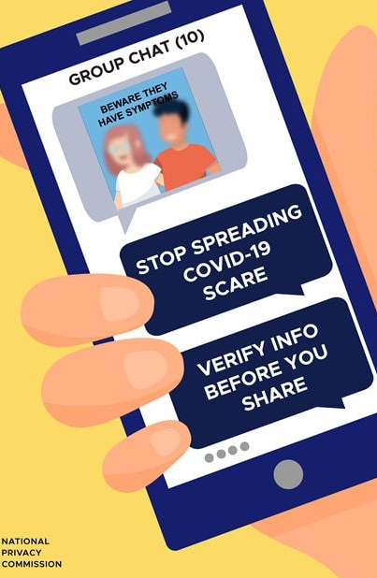
Why choose a medical health dataset?
The choice of research on a healthcare dataset like that of COVID-19 was done because pandemics often create a perfect storm of conflicting needs: the urgent, global demand for highly granular health data versus the severe privacy risks of releasing that same data.
RISK: If an agency releases that there is exactly one 35-year-old male with COVID-19 in a specific rural zip code, that individual is easily re-identified.
SOLUTION: Differential privacy solves this by allowing agencies to release these highly detailed statistics while adding enough noise to guarantee that no single person's health status or location can be definitively known by an attacker.
Notes:
In this research, I focused on healthcare datasets, particularly pandemic related data such as COVID-19. Pandemics create a challenging situation where there is a need for detailed real-time data, but also significant privacy risks.
For example, imagine a report stating that there is exactly one 35 year old male with COVID-19 in a small rural zip code. In a small community, this information could easily identify a specific individual.
Read the solution from slide

Slide 7
The primary aim of this dissertation is to design and evaluate a geospatially aware machine learning post-processing framework that enhances the privacy of differentially private datasets, whilst maintaining equivalent or superior data utility.
GOAL
Notes:
Read goal from slide
The question here is that if machine learning can help improve the usefulness of differentially private outbreak data without weakening privacy protection?
To address this question, I developed a model that incorporates, geospatial awareness meaning relationship between regions when analyzing outbreak data.

Slide 8
Approach overview
Data
Load and process the dataset
Choose a specific continent for our research
Trend Analysis
Define dynamic threshold
Find false positives
Experiment
Define weight penalty function
Introduce calibrated noise(Laplace noise)
Apply ML post-processing to the dataset
Analyse new_cases trend
Plot new_cases with time for all continents
Notes:
The overall approach consists of 3 key steps.
First, the outbreak data is processed by selecting the relevant columns, sorting the data, and removing any Nan values to avoid any computational errors. Then we plot a line graph for new_cases rising for different continents. Just like every outbreak spreads differently across the globe, the same trend was observed and we could see that Asian continent was the most affected at start of COVID-19 pandemic. Historically, looking back at other major outbreaks like SARS in 2002 and Swine Flu in 2009, those two as well had an initial outbreak first observed in the Asian continent. Therefore, we select the Asian continent for our research based on the information we have on it like its spread rate, waves, and other factors influencing the outbreak.
Second, since we do not have a dataset specifically validating if the new_cases arising across the continent can be considered as ground truth, we analyse the trend line and then define a dynamic threshold to validate from the data if it is a outbreak or not. Our computation focusses not on a single criteria to declare it an outbreak but we select 3 flags; first is the ‘magnitude flag’ for catching sudden case spikes, second is the ‘growth flag’ for knowing if the cases are growing consistently, these both flags together ensure any data dump(like a country reporting 3 weeks of backlogged cases in one day) does not raise any false alarms, and the third is the ‘persistence flag’ which measures how long does the outbreak last. Combining these 3 flags together, a consistent ground truth is defined. Then we use these rule based detectors to tell us if its an outbreak and with another condition which considers 7-days from now, these both together help in detecting the false positives.
Last, we have is the main experiment loop, where we add the carefully calibrated Laplace noise to the data. Then we split the data into train/validate/test sets based on the unique dates making sure that the model does not predict anything in earlier months based on its training data in the later months. This way the model is only shown the data of first few months or the first wave for its training. So, when we find the recent false positive rate by using a 28 day rolling mean, it then penalizes the model weights based on the weight penalty function. According to the ML post-processing theorem, noise is added before anything else, so privacy is never compromised by the ML layer

Slide 9
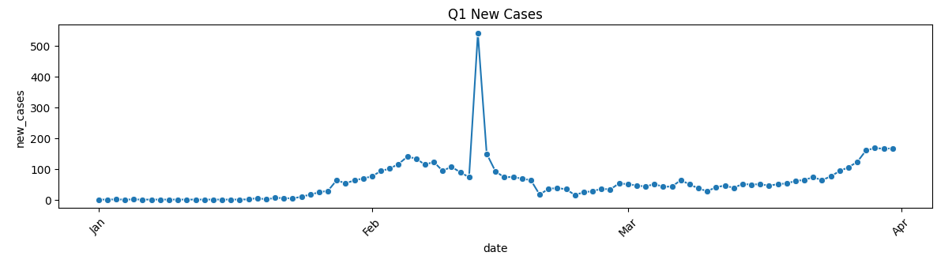

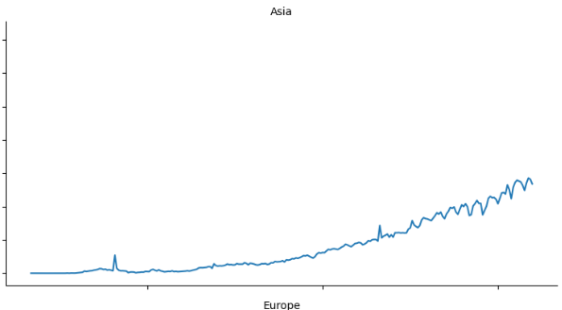
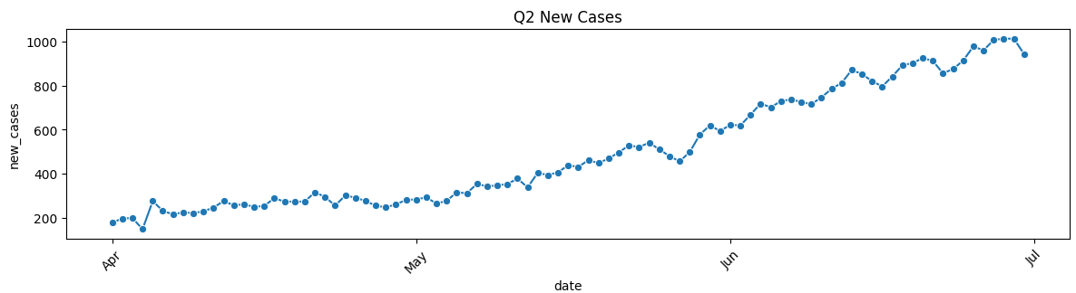
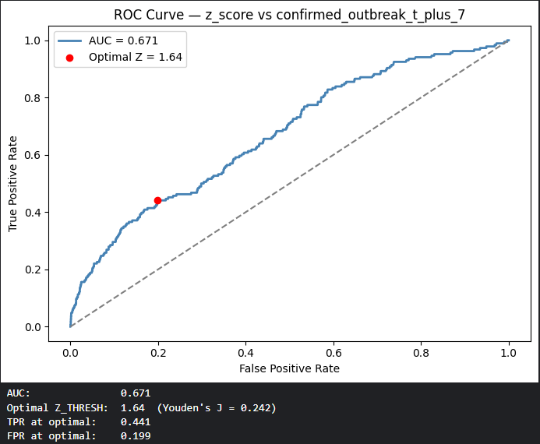
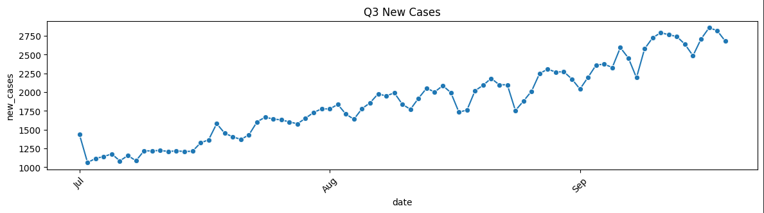
Notes:
On the top right corner we have the plot for rising covid cases in the Asian continent. When broken down in to quarters we see that in the first quarter there is one outlier for which the reason could be delay in the reporting, and we see a few 100 cases everyday. In the second quarter, that rise becomes more consistent and we see a few 200 cases everyday. In the third quarter it rises to a few thousand cases daily.
On the bottom right corner we have the ROC curve which is a plot for TPR vs FPR. The significance of this plot is that one of the flags use z_score to declare it an outbreak. But since the area under the curve is low, this criteria alone is not sufficient in defining an outbreak. We use the optimal threshold value of 1.64 in the detector later on.

Slide 10
confirmed_outbreak (ground truth, fixed forever)
confirmed_outbreak_t_plus_7 (FP definition, fixed forever)
clean z_score → ROC curve → Z=1.64
dp_case_count
baseline_f1 (confirmed_outbreak vs dp_confirmed_outbreak)
GBM trained on [train] inputs: dp features → threshold on [val]
DP features (7 total)
false_positive (dp_confirmed=1 AND t+7=0)
fp_penalty, sample_weight
dp_confirmed_outbreak (noisy detector)
ml_f1 on [test] (confirmed_outbreak vs ml_corrected_outbreak)
Notes:
It is important to note that the GBM gives a probability which we convert into binary classification based on the optimal_threshold. We do not define a single threshold but a range of 90 values between 0.05 and 0.95, and get pairs of threshold and F1 based on the validation data, then select the pair with maximum F1. This optimal threshold is feeded to the model to be applied on test set for classification.

Slide 11
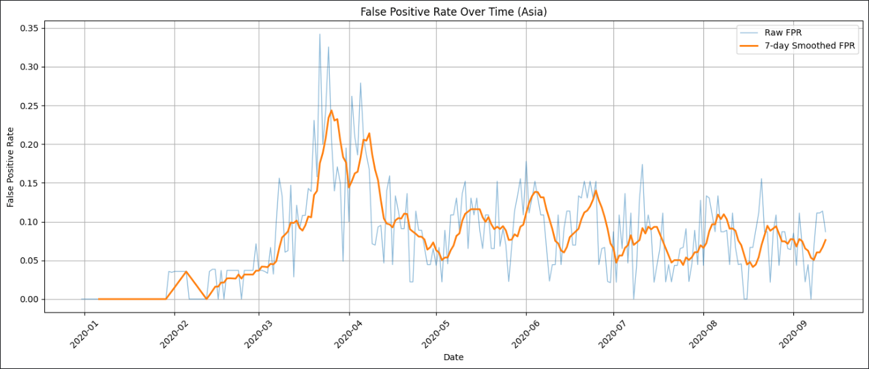
Evaluation
Weight Penalty Function
def calculate_region_penalty(row, alpha_pop=3.0, beta_fp=3.0, max_penalty=5.0): pop_term = 1.0 + alpha_pop * np.sqrt(pop_w) fp_term = 1.0 + beta_fp * fp_rate return min(pop_term * fp_term, max_penalty)
Notes:
To evaluate the proposed framework I introduced a region based weighting penalty function. The function also has a cap on the maximum penalty. This function adjusts the model’s behaviour depending on 2 key factors.
The first factor is ‘alpha_pop’, which is population sensitivity that controls how much a country’s population size amplifies the false positive penalty. The ‘pop_term’ also has the normalized population and we take a square root of it so that the countries with large share of population do not influence the penalty disproportionately meaning the training of the model is more fair. The second factor is ‘beta_fp’, which is false positive rate sensitivity that controls how much a region’s historical false alarm rate amplifies the penalty. The inclusion of 1 in both ensures a minimum penalty.
The reason for including geospatial awareness is that disease outbreaks often spread geographically. By incorporating spatial patterns into the model, we can improve outbreak detection even when the underlying data contains privacy noise. The penalty function dynamically adjusts model weights based on these conditions, ensuring that predictions remain balanced across regions with different characteristics.
This plot shows the proportion of false alarms generated per day across all Asian countries. In earlier months of January to March, we do not see much False positives as it is the start of the pandemic. But then in the middle phase of March and April, there is a sudden rise for which the reason could be the first wave. Then it smooths out until September. A 7-day window was chosen to match the natural weekly reporting cycle of COVID-19 data. Many countries systematically underreport on weekends and overreport on Mondays to compensate.

Slide 12
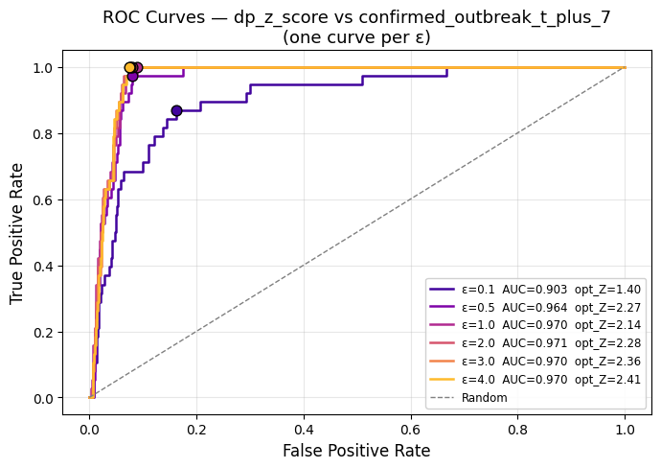
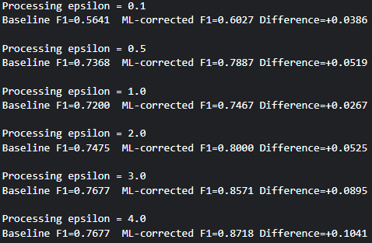
Results
At ε = 0.1, the ML-corrected model improves F1 from 0.5641 → 0.6027 (+3.86%), showing that ML can recover useful signal under strong differential privacy noise.
Performance improves as ε increases, reaching F1 = 0.8718 at ε = 4.0, compared to the baseline 0.7677 (+10.41%).
The model consistently outperforms the statistical baseline across all ε values, demonstrating the effectiveness of geospatial ML post-processing.
ROC curves show strong classification performance, with AUC values between 0.903 and 0.970.
Notes:
Read from the slide
We specifically chose F1-score and ROC curve for evaluation, the reason of choice for the former being that accuracy alone does not do any good because there are very few outbreak days in the data but combining it with recall will only score high when both false positives and false negatives are simultaneously low. For the latter, the choice was based on threshold-independent ranking. The gap between F1 and AUC proves that the binary thresholding step loses information that the continuous Z-score contains. If AUC and F1 were both high, there would be no gap for the GBM to bridge. If both were low, the system would be fundamentally flawed. The combination of high AUC and moderate F1 is the exact signature that says "the raw signal is good, but the decision boundary needs refinement“.
Overall the results confirm the expected trade-off between privacy and utility, while demonstrating that the proposed approach can improve performance under strict privacy constraints.

Slide 13
Future work
Take a bigger sample data, maybe even combining different datasets.
Train the data on previous outbreaks like SARS, MERS, Swine Flu.
Applying noise at the individual patient level before data reaches the server.
Adaptive Differential Privacy Mechanisms
Notes:
Read from the slide

Slide 14
Report Outline
Plots for rising cases of COVID-19 for all continents
More detailed evaluation of weight penalty function
Importance of ROC curves
Security & Privacy considerations
Notes:
Read from the slide
I would like to end my presentation with my honest opinion of was I able to achieve what I intended to. The answer is yes, to some extent as there is always a good chance for improvement . Also I do not find the optimal values for the 2 key terms in my weight penalty function but I simply do an explorative study and note my findings.

